Slide 1
Image Enhancement using Deep Neural Network Architectures.
a project done by Snigdha Tarua
under the guidance of Hemant Kumar
Final Project Review

Slide 2
Objective.
Image enhancement with :
Colorization
Corrupt images correction
Super-resolution
Using multiple Neural Network Architecture :
Convolutional Neural Network
Residual Convolutional Neural Network
Autoencoder Convolutional Neural Network
Notes:
3 Main Parts
Colorization
Corrupt Image correction
Super Resolution
For each of these 3 problem we use 3 architectures of neural network
CNN, Vanilla
RCNN
AECNN

Slide 3



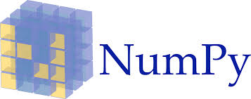


Resources
Tensorflow
Keras version 2.1.6-tf
numpy v1.16
skimage Version 0.14.2
matplotlib v3.0.3
pandas v0.24.2
Colab pro
Notes:
These are the packages used in this project
TF and Keras for all the neural network design, implementation and control.
Numpy to store and tweak the array form of image
Sci kit image for image manipulation

Slide 4
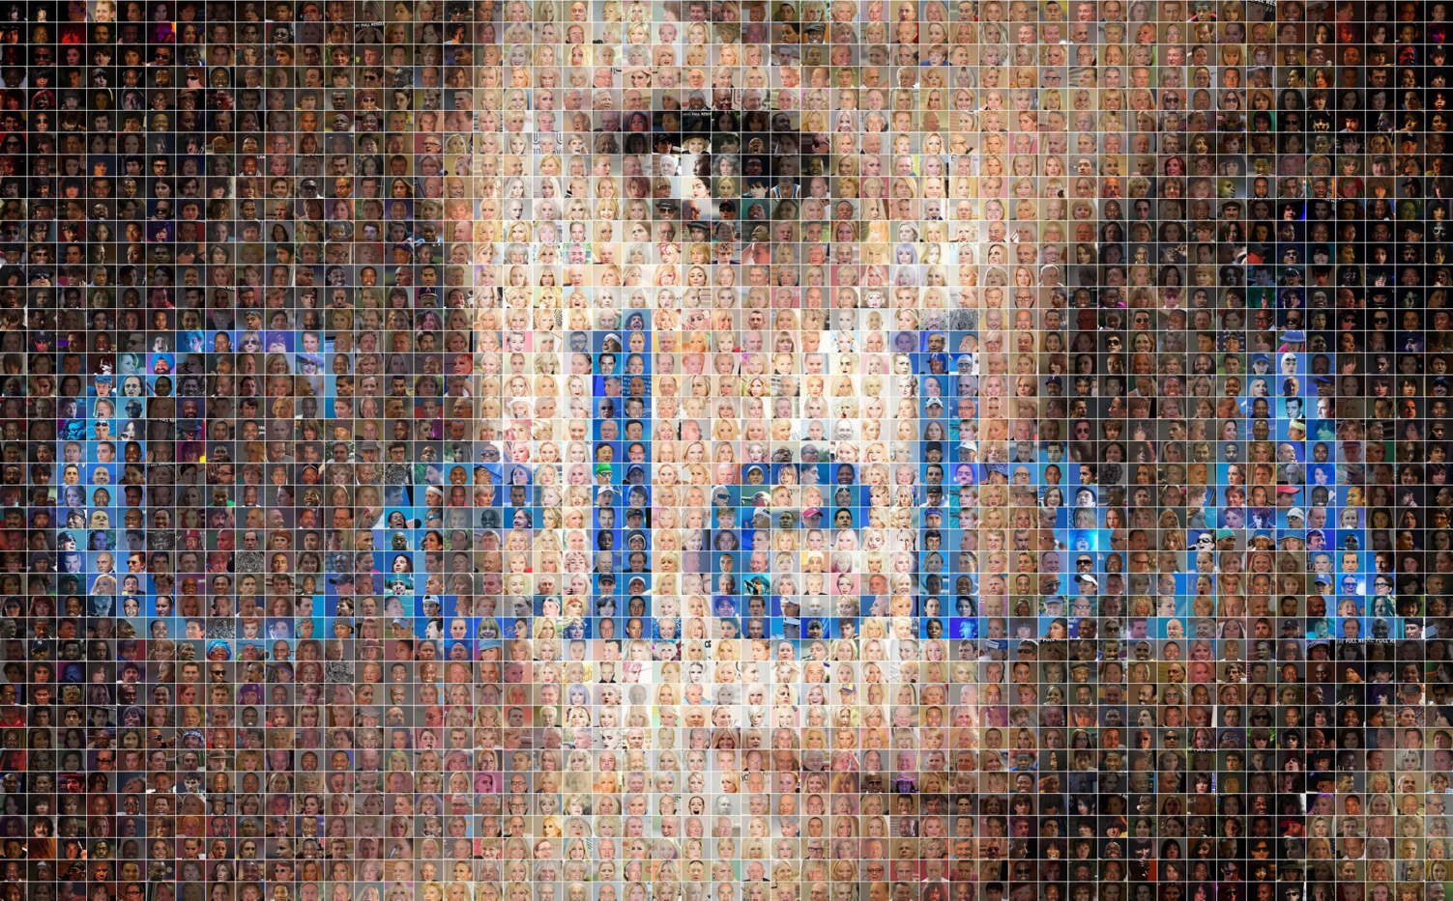
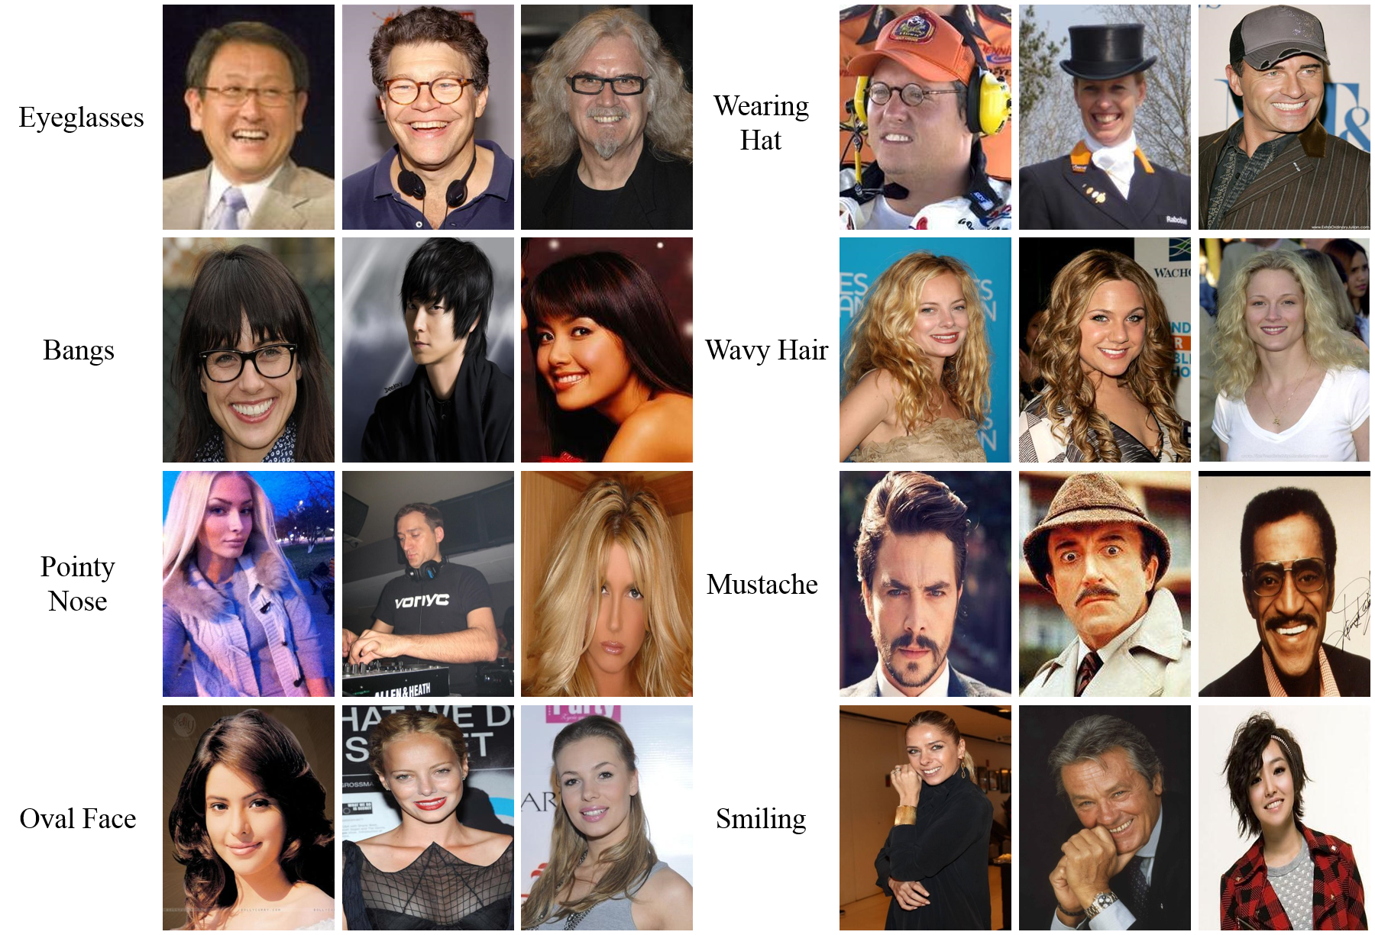
Dataset
CelebFaces Attributes Dataset (CelebA)
200K image of celebrity faces
images in this dataset cover large pose variations and background clutter
Multimedia Laboratory, The Chinese University of Hong Kong
Notes:
For the Dataset being used
We picked a image dataset of Celebrity faces
Its called the CelebA dataset developed by the University of Hong Kong
We picked it cause the nature of the images
That is the faces and most images that we humans take are of faces
This dataset consists of 200K images consisting of various poses and background.
Our hope is that the algorithm learns the human face semantics as in color of hair, texture of skin or the roundness of the iris.

Slide 5
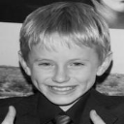
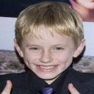
Colorization
It’s a hard problem to solve.
Involves to some extend semantic identification of images.
Before few years, all colorization was done completely manually by an artist.
Image Colorization from Grayscale to Color

Slide 6
Colorization - our solution
Neural Network Architectures
Input : greyscale of the image
Image Size : 3 x 128 x 128
Output : Color ( CIE-LAB color space ) of the image
Keras Generator to feed the Images to model

Slide 7
Colorization - our solution
a (-128 -> 127)
L (0 -> 100)
MODEL
b (-128 -> 127)

Slide 8
Colorization - our solution
a (-1 -> 1)
L (0 -> 1)
MODEL
b (-1 -> 1)

Slide 9
Colorization - the Pipeline
(1x128x128)
Input
RGB (?x?)
RGB (128x128)
LAB (128x128)
MODEL
Output
Preprocessing
(2x128x128)
Training
Notes:
Preprocessing done with the help of Generator class from fit generator from keras.

Slide 10



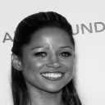
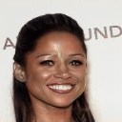
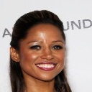
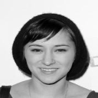
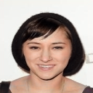
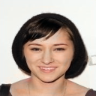
Convolutional Neural Network.
input
prediction
actual
Input : greyscale of the image
Input Size : 1 x 128 x 128
Training epochs : 10
Training period : 10 hours
Output Size : 2 x 128 x 128

Slide 11
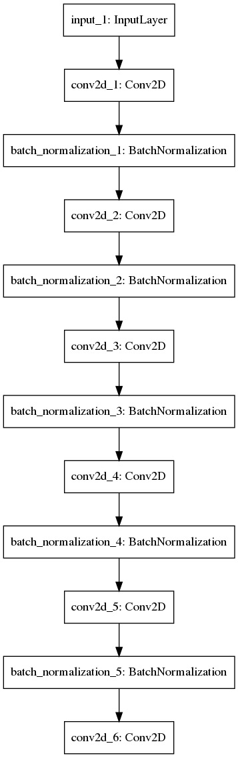
Convolutional Neural Network.
Conv2d_1 : filters:= 32
kernel_size:= (7,7)
padding:= same
activation_layer:= ‘relu’
Conv2d_2 : filters:= 64
kernel_size:= (5,5)
padding:= same
activation_layer:= ‘relu’
Conv2d_3 : filters:= 128
kernel_size:= (3,3)
padding:= same
activation_layer:= ‘relu’
Conv2d_4: filters:= 64
kernel_size:= (3,3)
padding:= same
activation_layer:= ‘relu’
Conv2d_5 : filters:= 64
kernel_size:= (3,3)
padding:= same
activation_layer:= ‘relu’
Conv2d_6 : filters:= 2
kernel_size:= (3,3)
padding:= same
activation_layer:= ‘tanh’

Slide 12
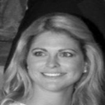
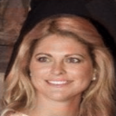
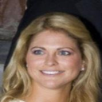
Convolutional Neural Network - close look
input
prediction
actual
Notes:
Lips
Hair
Eyes
It understands a face.

Slide 13
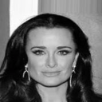
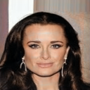
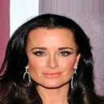
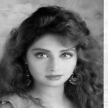
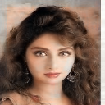
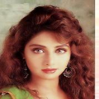
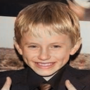
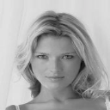
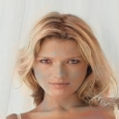
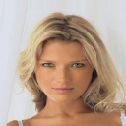
Convolutional Neural Network - more predictions
input
prediction
actual
input
prediction
actual
Notes:
Here are some more Example
Red hair
Hair color identification
Skin tone.

Slide 14
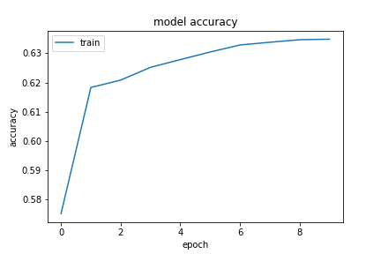
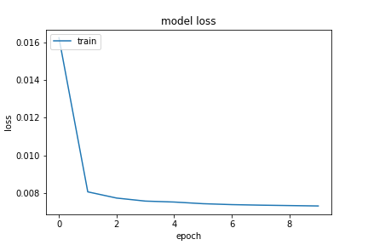
Convolutional Neural Network - loss & accuracy curve

Slide 15


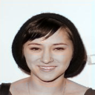

Residual Neural Network.
input
prediction
actual
Input : greyscale of the image
Input Size : 1 x 128 x 128
Training epochs : 10
Training period : 12 hours
Also uses Convolutional Layers.

Slide 16
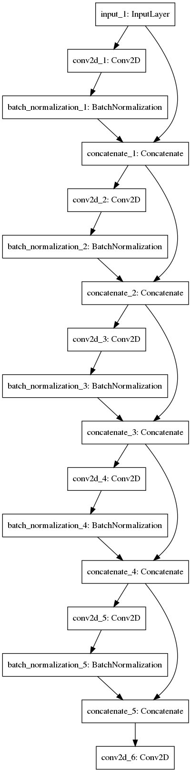
Residual Neural Network.
Conv2d_1 : filters:= 32
kernel_size:= (7,7)
padding:= same
activation_layer:= ‘relu’
Conv2d_2 : filters:= 64
kernel_size:= (5,5)
padding:= same
activation_layer:= ‘relu’
Conv2d_3 : filters:= 128
kernel_size:= (3,3)
padding:= same
activation_layer:= ‘relu’
Conv2d_4: filters:= 64
kernel_size:= (3,3)
padding:= same
activation_layer:= ‘relu’
Conv2d_5 : filters:= 64
kernel_size:= (3,3)
padding:= same
activation_layer:= ‘relu’
Conv2d_6 : filters:= 2
kernel_size:= (3,3)
padding:= same
activation_layer:= ‘tanh’

Slide 17
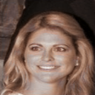
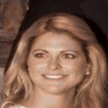
Residual Neural Network - close look
input
prediction
actual

Slide 18
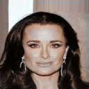
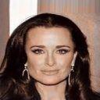
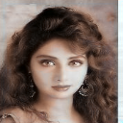
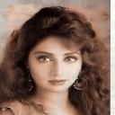
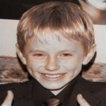
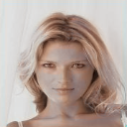
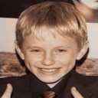
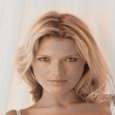
Residual Neural Network - more predictions
input
prediction
actual
input
prediction
actual
Notes:
Sepia hue to the photos

Slide 19
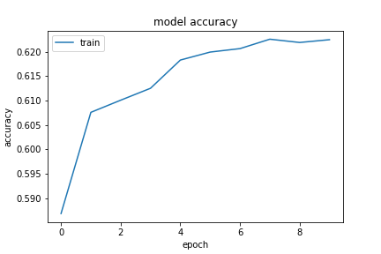
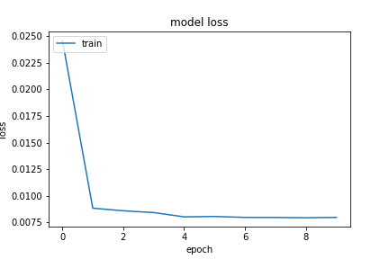
Residual Neural Network - loss & accuracy curve

Slide 20

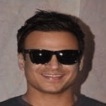


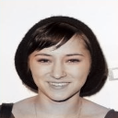

AutoEncoder Neural Network.
input
prediction
actual
Input : greyscale of the image
Input Size : 1 x 128 x 128
Training epochs : 10
Training period : 14 hours
Also uses Convolutional Layers.

Slide 21
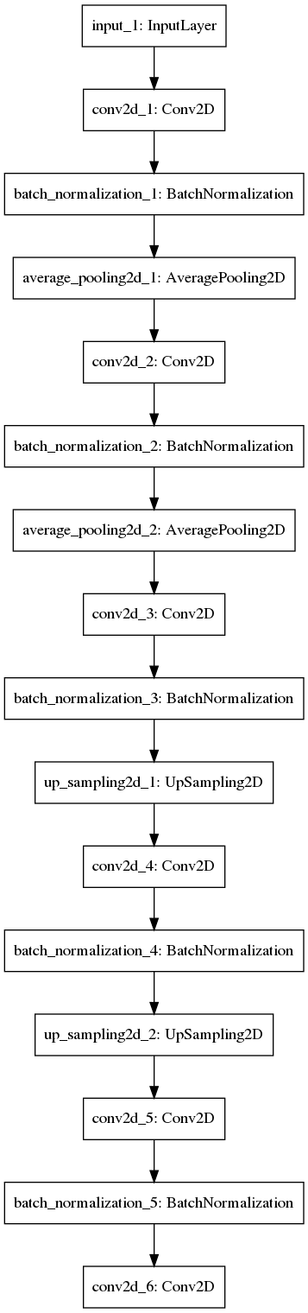
AutoEncoder Neural Network.
Conv2d_1 : filters:= 32
kernel_size:= (7,7)
padding:= same
activation_layer:= ‘relu’
Conv2d_2 : filters:= 64
kernel_size:= (5,5)
padding:= same
activation_layer:= ‘relu’
Conv2d_3 : filters:= 128
kernel_size:= (3,3)
padding:= same
activation_layer:= ‘relu’
Conv2d_4: filters:= 64
kernel_size:= (3,3)
padding:= same
activation_layer:= ‘relu’
Conv2d_5 : filters:= 64
kernel_size:= (3,3)
padding:= same
activation_layer:= ‘relu’
Conv2d_6 : filters:= 2
kernel_size:= (3,3)
padding:= same
activation_layer:= ‘tanh’

Slide 22
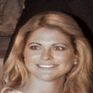
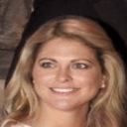
AutoEncoder Neural Network. - close look
input
prediction
actual

Slide 23
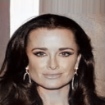
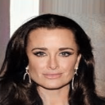

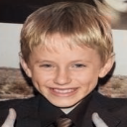
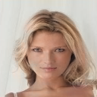
AutoEncoder Neural Network. - more predictions
input
prediction
actual
input
prediction
actual

Slide 24


AutoEncoder Neural Network - loss & accuracy curve

Slide 25


Colorization - Result
input
CNN
RCNN
AECNN
actual
Notes:
Although AECNN looks the best overall.
Best Color reproduction is by the Vanilla AECNN although it produces grey patches.

Slide 26


Corrupt Image Correction
Image noise on low light scene.
Image noise reduction with object detection and semantic enhancement.
Image Correction from noise to clean Image

Slide 27

Corrupt Image Correction - the Pipeline
RGB (?x?)
RGB (128x128)
RGB (128x128)
Input
MODEL
Output
With added noise
Preprocessing
Training
Notes:
Preprocessing done with the help of Generator class from fit generator from keras.
!! NORMALIZATION from 258 to 0->1

Slide 28






Convolutional Neural Network
input
prediction
actual
Input : Image with added noise
Input Size : 3 x 128 x 128
Training epochs : 10
Training period : 11 hours
Output Size : 3 x 128 x 128

Slide 29
Convolutional Neural Network
Conv2d_1 : filters:= 32
kernel_size:= (7,7)
padding:= same
activation_layer:= ‘relu’
Conv2d_2 : filters:= 64
kernel_size:= (5,5)
padding:= same
activation_layer:= ‘relu’
Conv2d_3 : filters:= 128
kernel_size:= (3,3)
padding:= same
activation_layer:= ‘relu’
Conv2d_4: filters:= 64
kernel_size:= (3,3)
padding:= same
activation_layer:= ‘relu’
Conv2d_5 : filters:= 64
kernel_size:= (3,3)
padding:= same
activation_layer:= ‘relu’
Conv2d_6 : filters:= 2
kernel_size:= (3,3)
padding:= same
activation_layer:= ‘tanh’
Notes:
Multiple Convolutional layer
With Batch normalization in between it
Input takes as 128 128 1
Output as 128 128 2

Slide 30


Convolutional Neural Network - close look
input
prediction
actual
Notes:
Lips
Hair
Eyes
It understands a face.

Slide 31










Convolutional Neural Network - more predictions
input
prediction
actual
input
prediction
actual
Notes:
Here are some more Example
Red hair
Color of hair by face.

Slide 32


Convolutional Neural Network.

Slide 33







Residual Neural Network.
input
prediction
actual
Input : Image with added noise
Input Size : 3 x 128 x 128
Training epochs : 10
Training period : 13 hours
Output Size : 3 x 128 x 128
Notes:
128 because as 2’s expoenents.

Slide 34
Residual Neural Network
Conv2d_1 : filters:= 32
kernel_size:= (7,7)
padding:= same
activation_layer:= ‘relu’
Conv2d_2 : filters:= 64
kernel_size:= (5,5)
padding:= same
activation_layer:= ‘relu’
Conv2d_3 : filters:= 128
kernel_size:= (3,3)
padding:= same
activation_layer:= ‘relu’
Conv2d_4: filters:= 64
kernel_size:= (3,3)
padding:= same
activation_layer:= ‘relu’
Conv2d_5 : filters:= 64
kernel_size:= (3,3)
padding:= same
activation_layer:= ‘relu’
Conv2d_6 : filters:= 2
kernel_size:= (3,3)
padding:= same
activation_layer:= ‘tanh’

Slide 35


Residual Neural Network - close look
input
prediction
actual

Slide 36










Residual Neural Network - more predictions
input
prediction
actual
input
prediction
actual

Slide 37


Residual Neural Network

Slide 38





AutoEncoder Neural Network.
input
prediction
actual
Input : Image with added noise
Input Size : 3 x 128 x 128
Training epochs : 10
Training period : 15 hours
Output Size : 3 x 128 x 128
Notes:
128 because as 2’s expoenents.

Slide 39
AutoEncoder Neural Network
Conv2d_1 : filters:= 32
kernel_size:= (7,7)
padding:= same
activation_layer:= ‘relu’
Conv2d_2 : filters:= 64
kernel_size:= (5,5)
padding:= same
activation_layer:= ‘relu’
Conv2d_3 : filters:= 128
kernel_size:= (3,3)
padding:= same
activation_layer:= ‘relu’
Conv2d_4: filters:= 64
kernel_size:= (3,3)
padding:= same
activation_layer:= ‘relu’
Conv2d_5 : filters:= 64
kernel_size:= (3,3)
padding:= same
activation_layer:= ‘relu’
Conv2d_6 : filters:= 2
kernel_size:= (3,3)
padding:= same
activation_layer:= ‘tanh’

Slide 40



AutoEncoder Neural Network - close look
input
prediction
actual

Slide 41












AutoEncoder Neural Network - more predictions
input
prediction
actual
input
prediction
actual

Slide 42


AutoEncoder Neural Network

Slide 43




Corrupt Image Correction - Result
input
CNN
RCNN
AECNN
actual
Notes:
Best is AECNN with over 88% accuracy
This accracy is of MSE therefore cannot be correlated with the color reproduction
Again, AECNN did the best but the devil is in the details.
If you look close enough you would see that RCNN managed to reproduces the fine textures

Slide 44
Super Resolution
Increasing Resolution of as been a fiction since the beginning of fiction movies.
We intend to use Neural Network to increase resolution of images.
The application of this is from enhancing security footage to historic photos.
Being able to Zoom, without losing Quality.
Increasing Resolution of images

Slide 45
Super Resolution - the Pipeline
RGB (?x?)
RGB (128x128)
RGB (64x64)
Input
MODEL
Output
Down-Sampling
Preprocessing
Training
Notes:
Preprocessing done with the help of Generator class from fit generator from keras.

Slide 46






Convolutional Neural Network.
input
prediction
actual
Input : Image with added noise
Input Size : 3 x 64 x 64
Training epochs : 10
Training period : 11 hours
Output Size : 3 x 128 x 128
Notes:
Input : greyscale of the image
Input Size : 3 x 128 x 128
Training epochs : 10
Training period : 15 days
Trained on 200000 images of faces of celebrity
We will come back to the results after dicussing the model itself

Slide 47

Convolutional Neural Network.
Conv2d_1 : filters:= 32
kernel_size:= (7,7)
padding:= same
activation_layer:= ‘relu’
Conv2d_2 : filters:= 64
kernel_size:= (5,5)
padding:= same
activation_layer:= ‘relu’
Conv2d_3 : filters:= 128
kernel_size:= (3,3)
padding:= same
activation_layer:= ‘relu’
Conv2d_4: filters:= 64
kernel_size:= (3,3)
padding:= same
activation_layer:= ‘relu’
Conv2d_5 : filters:= 64
kernel_size:= (3,3)
padding:= same
activation_layer:= ‘relu’
Conv2d_6 : filters:= 2
kernel_size:= (3,3)
padding:= same
activation_layer:= ’tanh’
Notes:
Multiple Convolutional layer
With Batch normalization in between it
Input takes as 128 128 1
Output as 128 128 2

Slide 48


Convolutional Neural Network - close look
input
prediction
actual
Notes:
Lips
Hair
Eyes
It understands a face.

Slide 49










Convolutional Neural Network. - more predictions
input
prediction
actual
input
prediction
actual
Notes:
Here are some more Example
Red hair
Color of hair by face.

Slide 50


Convolutional Neural Network

Slide 51



Residual Neural Network.
input
prediction
actual
Input : Image with added noise
Input Size : 3 x 64 x 64
Training epochs : 10
Training period : 15 hours
Output Size : 3 x 128 x 128
Notes:
128 because as 2’s expoenents.

Slide 52

Residual Neural Network
Conv2d_1 : filters:= 32
kernel_size:= (7,7)
padding:= same
activation_layer:= ‘relu’
Conv2d_2 : filters:= 64
kernel_size:= (5,5)
padding:= same
activation_layer:= ‘relu’
Conv2d_3 : filters:= 128
kernel_size:= (3,3)
padding:= same
activation_layer:= ‘relu’
Conv2d_4: filters:= 64
kernel_size:= (3,3)
padding:= same
activation_layer:= ‘relu’
Conv2d_5 : filters:= 64
kernel_size:= (3,3)
padding:= same
activation_layer:= ‘relu’
Conv2d_6 : filters:= 2
kernel_size:= (3,3)
padding:= same
activation_layer:= ’tanh’

Slide 53

Residual Neural Network - close look
input
prediction
actual

Slide 54





Residual Neural Network - more predictions
input
prediction
actual
input
prediction
actual

Slide 55


Residual Neural Network

Slide 56
AutoEncoder Neural Network
input
prediction
actual
Input : Image with added noise
Input Size : 3 x 64 x 64
Training epochs : 10
Training period : 15 hours
Output Size : 3 x 128 x 128
Notes:
128 because as 2’s expoenents.

Slide 57

AutoEncoder Neural Network
Conv2d_1 : filters:= 32
kernel_size:= (7,7)
padding:= same
activation_layer:= ‘relu’
Conv2d_2 : filters:= 64
kernel_size:= (5,5)
padding:= same
activation_layer:= ‘relu’
Conv2d_3 : filters:= 128
kernel_size:= (3,3)
padding:= same
activation_layer:= ‘relu’
Conv2d_4: filters:= 64
kernel_size:= (3,3)
padding:= same
activation_layer:= ‘relu’
Conv2d_5 : filters:= 64
kernel_size:= (3,3)
padding:= same
activation_layer:= ‘relu’
Conv2d_6 : filters:= 2
kernel_size:= (3,3)
padding:= same
activation_layer:= ’tanh’

Slide 58

AutoEncoder Neural Network - close look
input
prediction
actual

Slide 59



AutoEncoder Neural Network - more predictions
input
prediction
actual
input
prediction
actual

Slide 60


AutoEncoder Neural Network.

Slide 61




SuperResolution - Result
input
CNN
RCNN
AECNN
actual

Slide 62
SuperResolution - Result Closer Look
input
CNN
RCNN
AECNN
actual

Slide 63
References
Szegedy, Christian, et al. "Going deeper with convolutions." Proceedings of the IEEE conference on computer vision and pattern recognition. 2015.
Fenu, Stefano, and Carden Bagwell. "Image Colorization using Residual Networks."
Iizuka, Satoshi, Edgar Simo-Serra, and Hiroshi Ishikawa. "Let there be color!: joint end-to-end learning of global and local image priors for automatic image colorization with simultaneous classification." ACM Transactions on Graphics (TOG) 35.4 (2016): 110.
Goodfellow, Ian, et al. "Generative adversarial nets." Advances in neural information processing systems. 2014.
Krizhevsky, Alex, Ilya Sutskever, and Geoffrey E. Hinton. "Imagenet classification with deep convolutional neural networks." Advances in neural information processing systems. 2012.
Lehtinen, Jaakko, et al. "Noise2Noise: LeaArning Image Restoration without Clean Data." arXiv preprint arXiv:1803.04189 (2018).
Cheng, Zezhou, Qingxiong Yang, and Bin Sheng. "Deep colorization." Proceedings of the IEEE International Conference on Computer Vision. 2015.
Szegedy, Christian, et al. "Inception-v4, inception-resnet and the impact of residual connections on learning." AAAI. Vol. 4. 2017.
Oord, Aaron van den, Nal Kalchbrenner, and Koray Kavukcuoglu. "Pixel recurrent neural networks." arXiv preprint arXiv:1601.06759 (2016).

Slide 64
He, Kaiming, et al. "Deep residual learning for image recognition." Proceedings of the IEEE conference on computer vision and pattern recognition. 2016.
Hinton, Geoffrey, Oriol Vinyals, and Jeff Dean. "Distilling the knowledge in a neural network." arXiv preprint arXiv:1503.02531 (2015).
Ioffe, Sergey, and Christian Szegedy. "Batch normalization: Accelerating deep network training by reducing internal covariate shift." arXiv preprint arXiv:1502.03167 (2015).
Simonyan, Karen, and Andrew Zisserman. "Very deep convolutional networks for large-scale image recognition." arXiv preprint arXiv:1409.1556 (2014).
Chatfield, Ken, et al. "Return of the devil in the details: Delving deep into convolutional nets." arXiv preprint arXiv:1405.3531(2014).
Sermanet, Pierre, et al. "Overfeat: Integrated recognition, localization and detection using convolutional networks." arXiv preprint arXiv:1312.6229 (2013).
Tafti, Abdolreza Dehghani, and E. Mirsadeghi. "Neural network with median filter for image noise reduction." Proc. Int. Conf. Mechatronic Syst. Mater.. 2012.
Glasner, Daniel, Shai Bagon, and Michal Irani. "Super-resolution from a single image." Computer Vision, 2009 IEEE 12th International Conference on. IEEE, 2009.
Zhang, Kai, Wangmeng Zuo, and Lei Zhang. "Learning a single convolutional super-resolution network for multiple degradations." IEEE Conference on Computer Vision and Pattern Recognition. Vol. 6. 2018.

